Slide 1
Industry Session – Mixed Criticality and Multi-Core
David Corman
Program Director, Cyber Physical Systems
National Science Foundation

Slide 2
Outline
Need and terms of reference
Progress
Remaining

Slide 3
What do we mean by Criticality
Criticality (Aerospace)– assurance against failure. Frequently refer to levels from DO-178B
Level A – catastrophic. Failure may cause crash. Loss of critical function required to safely fly and land
Level B – hazardous. Negative impact on safety or performance, reduced ability to operate aircraft, safety significant
Level C – major. Failure is significant but lesser impact than B. May lead to passenger discomfort rather than injuries, increased workload
Level D – minor. Failure noticable, but lesser impact. Inconvenience vs distress.
Level E –Failure has no impact on safety, operation, or workload
Similar issues in automotive (Automotive Safety and Integrity Levels)

Slide 4
Mixed Critical Systems Definition
Two or more levels of criticality on same system
Mixed criticality systems - a mixed-critical system is an integrated suite of hardware, operating system and middleware services and application software that supports the execution of safety-critical, mission-critical, and non-critical software within a single, secure compute platform
Ref: Joint white paper from Boeing, LM, Honeywell, AFRL, and Northrop from 2009 CPS Week

Slide 5
Criticality Levels – Focus on UAS
Flight Critical | Required to prevent ~ Unintended loss of life. Unintended reduction of public safety. Substantial damage to the vehicle or its support structure. Loss of vehicle Unintended event (e.g., crash) into politically sensitive area
Mission Critical | Required to prevent ~ Unintended loss of the vehicle’s function (mission sensors or other effectors). Unintended loss of support structure function (e.g., ability of operator to use on-board UAV sensors).
Maintenance Critical | Required to prevent ~ Inefficient use of the vehicle’s resources. Inefficient use of ground support structure.
Red: Boeing Presentation at S5 – June 2011

Slide 6
Aerospace Motivation
Today most platforms incorporate subsystems with separate levels of criticality
Would like to evolve to more integrated platforms / systems that can be developed, meet stringent requirements for cost, SWAP, and be certified airworthy as rapidly as possible
Reduced number of processors and you reduce the weight, power required, heat generated, and cost to build, but
Increase risk in development, verification, validation, and certification

Slide 7
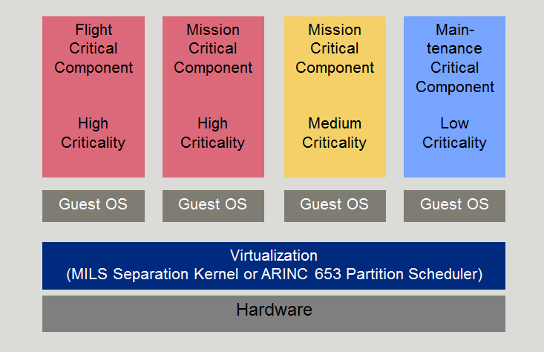
Some Initial Thoughts – From AFRL Safe & Secure Systems & Software Symposium (S5)

Slide 8
Roadmap from MCAR Whitepaper
Not quite but some progress
More challenges with Multi-core

Slide 9
Progress
Much research progress on CPS with single processors -- great reference “Mixed Criticality Systems – A Review”, Burns and Davis, Dept of Computer Science, University of York, York, UK
WCET analysis
Scheduling models
Fixed priority scheduling
Maximize priority of high critical tasks subject to system being schedulable
Slack Scheduling approaches – low criticality jobs are run in slack created by high criticality jobs using only low criticality execution budgets
Some progress on multi-core but doesn’t seem to have been a research focus over last several years
Multi-core activity in CPS has been largely in the application side
Looking at utilization supporting multiple lower criticality applications including auto infotainment
Some activity in dynamic scheduling for automotive sensor fusion

Slide 10
Future
CPS program typically includes panels dealing with platforms and infrastructures and safety / verification
Both provide logical areas for mixed criticality research at foundational level
Potentially impactful area of research with TTP option
Important to check what has been previously funded in CPS, CSR, and CCF core programs.

